Slide 1

Chapter 5
Designing the Architecture
This lecture is based on the Chapter 5 of the book “Software Engineering: Theory and Practice”.

Slide 2
Chapter 5 Objectives
Examine different types of decomposition
Compare competing designs
Document the design
Verify architecture meets the requirements

Slide 3
5.1 The Design Process
Design is the creative process of figuring out how to implement all of the customer’s requirements; the resulting plan is also called the design
Early design decisions address the system’s architecture
Later design decisions address how to implement the individual units

Slide 4
5.1 The Design Process
Design is a Creative Process
Design is an intellectually challenging task
  Numerous possibilities the system must accommodate
  Nonfunctional design goals (e.g., ease of use, ease to maintain)
  External factors (e.g., standard data formats, government regulations)
We can improve our design by studying examples of good design
Most design work is routine design, solve problem by reusing and adapting solutions from similar problems

Slide 5
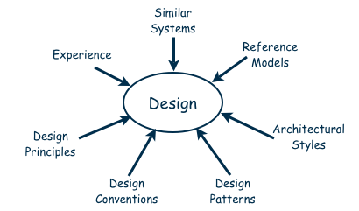
5.1 The Design Process
Design is a Creative Process (continued)
Many ways to leverage existing solutions
  Cloning: Borrow design/code in its entirety, with minor adjustments
  Reference models: Generic architecture that suggests how to decompose the system

Slide 6
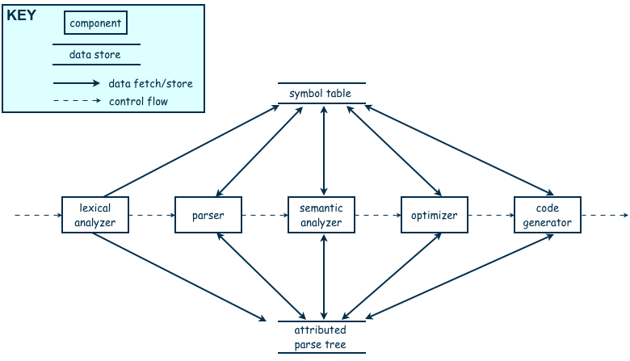
5.1 The Design Process
Design is a Creative Process (continued)
Reference model for a compiler

Slide 7
5.1 The Design Process
Design is a Creative Process (continued)
More typically, a reference model will not exist for the problem
Software architectures have generic solutions too, referred to as architectural styles
  Focusing on one architectural style can create problems
  Good design is about selecting, adapting, and integrating several architectural design styles to produce the desired result

Slide 8
5.1 The Design Process
Design is a Creative Process (continued)
Many tools for understanding options and evaluating chosen architecture, including:
  Design patterns: generic solutions for making lower-level design decisions
  Design convention or idiom: collection of design decisions and advice that, taken together, promotes certain design qualities
  Innovative design: characterized by irregular bursts of progress that occur as we have flashes of insight
  Design principles: descriptive characteristics of good design

Slide 9
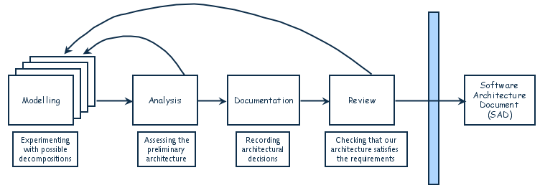
5.1 The Design Process
Design Process Model
Designing software system is an iterative process
The final outcome is the software architecture document (SAD)

Slide 10
5.2 Modeling Architectures
Collection of models helps to answer whether the proposed architecture meets the specified requirements
Six ways to use the architectural models:
  to understand the system
  to determine amount of reuse from other systems and the reusability of the system being designed
  to provide blueprint for system construction
  to reason about system evolution
  to analyze dependencies
  to support management decisions and understand risks
  A typical technique: box-and-arrow diagram

Slide 11
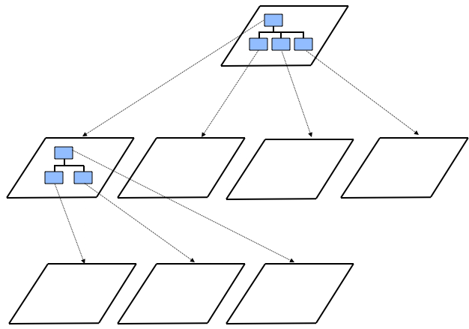
5.3 Decomposition and Views
High-level description of system’s key elements
Creating a hierarchy of information with increasing details
Top
level
First level of
decomposition
Second level of
decomposition

Slide 12
5.3 Decomposition and Views
Popular Design Methods
Some design problems have no existing solutions
  Designers must decompose to isolate key problems
Some popular design methods:
  Functional decomposition
  Feature-oriented decomposition
  Data-oriented decomposition
  Process-oriented decomposition
  Event-oriented decomposition
  Object-oriented design

Slide 13
5.3 Decomposition and Views
Popular Design Methods
Functional decomposition
  partitions functions or requirements into modules
  begins with the functions that are listed in the requirements specification
  lower-level designs divide these functions into subfunctions, which are then assigned to smaller modules
  describes which modules (subfunctions) call each other

Slide 14
5.3 Decomposition and Views
Popular Design Methods
  Feature-oriented decomposition
  assigns features to modules
  high-level design describes the system in terms of a service and a collection of features
  lower-level designs describe how each feature augments the service and identifies interactions among features

Slide 15
5.3 Decomposition and Views
Popular Design Methods
  Data-oriented decomposition
  focuses on how data will be partitioned into modules
  high-level design describes conceptual data structures
  lower-level designs provide detail as to how
    data are distributed among modules
    distributed data realize the conceptual models

Slide 16
5.3 Decomposition and Views
Popular Design Methods
  Process-oriented decomposition
  partitions the system into concurrent processes
  high-level design:
    identifies the system’s main tasks
    assigns tasks to runtime processes
    explains how the tasks coordinate with each other
  Lower-level designs describe the processes in more detail

Slide 17
5.3 Decomposition and Views
Popular Design Methods
  Event-oriented decomposition
  focuses on the events that the system must handle and assigns responsibility for events to different modules
  high-level design catalogues the system’s expected input events
  lower-level designs decompose the system into states and describe how events trigger state transformations

Slide 18
5.3 Decomposition and Views
Popular Design Methods
  Object-oriented decomposition
  assigns objects to modules
  high-level design identifies the system’s object types and explains how objects are related to one another
  lower-level designs detail the objects’ attributes and operations

Slide 19
5.3 Decomposition and Views
Popular Design Methods (continued)
Component
Subsystem
Runtime process
Module
Class
Package
Library
Procedure
Software unit
Modular
Well-defined

Slide 20
5.3 Decomposition and Views
Popular Design Methods (continued)
A design is modular when each activity of the system is performed by exactly one software unit, and when the inputs and outputs of each software unit are well-defined
A software unit is well-defined if its interface accurately and precisely specifies the unit’s externally visible behavior

Slide 21
5.3 Decomposition and Views
Architectural Views
Common types of architectural views include:
  Decomposition view
  Dependencies view
  Generalization view
  Execution view
  Implementation view
  Deployment view
  Work-assignment view

Slide 22
5.3 Decomposition and Views
Decomposition View
The decomposition view portrays the system as programmable units
This view is likely to be hierarchical
May be represented by multiple models

Slide 23
5.3 Decomposition and Views
Dependencies View
The dependencies view shows dependencies among software units
This view is useful in project planning
Also useful for assessing the impact of making a design change to some software unit

Slide 24
5.3 Decomposition and Views
Generalization View
The generalization view shows software units that are generalizations or specializations of one another
This view is useful when designing abstract or extendible software units

Slide 25
5.3 Decomposition and Views
Execution View
The execution view is the traditional box-and-arrow diagram that software architects draw, showing the runtime structure of a system in terms of its components and connectors
Each component is a distinct executing entity, possibly with its own program stack
A connector is some intercomponent communication mechanism, such as a communication channel, shared data repository, or remote procedure call

Slide 26
5.3 Decomposition and Views
Implementation View
The implementation view maps code units to the source file that contains their implementation
Helps programmers find the implementation of a software unit within a maze of source-code files

Slide 27
5.3 Decomposition and Views
Deployment View
The deployment view maps runtime entities, such as components and connectors, onto computer resources, such as processors, data stores, and communication networks
It helps the architect analyze the quality attributes of a design, such as performance, reliability, and security

Slide 28
5.3 Decomposition and Views
Work-assignment View
The work-assignment view decomposes the system’s design into work tasks that can be assigned to project teams
Helps project managers plan and allocate project resources, as well as track each team’s progress

Slide 29
5.4 Architectural Styles and Strategies
Pipes-and-Filter
Client-Server
Peer-to-Peer
Publish-Subscribe
Repositories
Layering

Slide 30
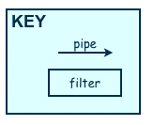
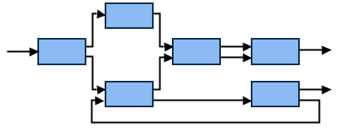
5.4 Architectural Styles and Strategies
Pipes-and-Filter
The system has
  Streams of data (pipe) for input and output
  Transformation of the data (filter)
KEY
pipe

Slide 31
5.4 Architectural Styles and Strategies
Pipes-and-Filter (continued)
Several important properties
  The designer can understand the entire system's effect on input and output as the composition of the filters
  The filters can be reused easily on other systems
  System evolution is simple
  Allow concurrent execution of filters
Drawbacks
  Not good for handling interactive application
  Parsing and unparsing of data can hamper system performance

Slide 32
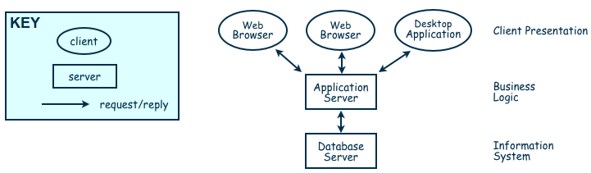
5.4 Architectural Styles and Strategies
Client-Server
Two types of components:
  Server components offer services
  Clients access them using a request/reply protocol
Client may send the server an executable function, called a callback
  The server subsequently calls under specific circumstances

Slide 33
5.4 Architectural Styles and Strategies
Peer-to-Peer (P2P)
Each component acts as its own process and acts as both a client and a server to other peer components.
Any component can initiate a request to any other peer component.
Characteristics
  Scale up well
  Increased system capabilities
  Highly tolerant of failures

Slide 34
5.4 Architectural Styles and Strategies
Publish-Subscribe
Components interact by broadcasting and reacting to events
  Component expresses interest in an event by subscribing to it
  When another component announces (publishes) that event has taken place, subscribing components are notified
  Implicit invocation is a common form of publish-subscribe architecture
    Registering: subscribing component associates one of its procedures with each event of interest
Characteristics
  Strong support for evolution and customization
  Easy to reuse components in other event-driven systems
  Need shared repository for components to share persistent data
  Difficult to test

Slide 35
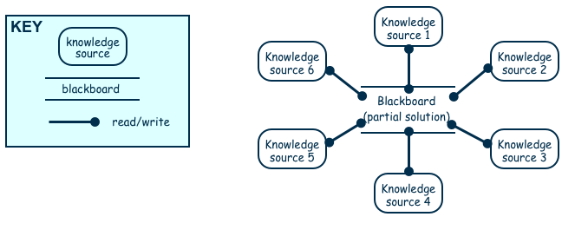
5.4 Architectural Styles and Strategies
Repositories
Two components
  A central data store
  A collection of components that operate on it to store, retrieve, and update information
The challenge is deciding how the components will interact
  A traditional database: transactions trigger process execution
  A blackboard: the central store controls the triggering process

Slide 36
5.4 Architectural Styles and Strategies
Repositories (continued)
Major advantage: openness
  Data representation is made available to various programmers (vendors) so they can build tools to access the repository
  But also a disadvantage: the data format must be acceptable to all components

Slide 37
5.4 Architectural Styles and Strategies
Layering
Layers are hierarchical
  Each layer provides service to the one outside it and acts as a client to the layer inside it
  Layer bridging: allowing a layer to access the services of layers below its lower neighbor
Advantages
  High levels of abstraction
  Relatively easy to add and modify a layer
Disadvantages
  Not always easy to structure system layers
  System performance may suffer from the extra coordination among layers

Slide 38
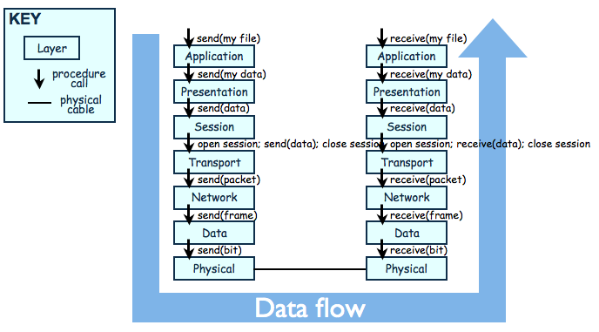
5.4 Architectural Styles and Strategies
Example of Layering System
The OSI Model

Slide 39
5.4 Architectural Styles and Strategies
Combining Architectural Styles
Actual software architectures rarely based on purely one style
Architectural styles can be combined in several ways
  Use different styles at different layers (e.g., overall client-server architecture with server component decomposed into layers)
  Use mixture of styles to model different components or types of interaction (e.g., client components interact with one another using publish-subscribe communications
If architecture is expressed as collection of models, documentation must be created to show relation between models

Slide 40
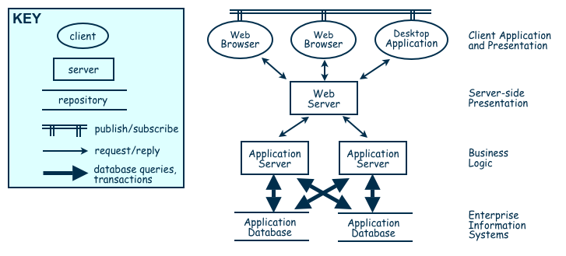
5.4 Architectural Styles and Strategies
Combination of Publish-Subscribe, Client-Server, and Repository Architecture Styles

Slide 41
5.5 Achieving Quality Attributes
Architectural styles provide general beneficial properties. To support specific quality attribute tactics are utilized:
  Modifiability
  Performance
  Security
  Reliability
  Robustness
  Usability
  Business goals

Slide 42
5.5 Achieving Quality Attributes
Modifiability
Design must be easy to change
Tactics for minimizing the number of software units affected by a change focus on clustering the anticipated changes
Tactics for minimizing the impact on indirectly affected units focus on reducing dependencies

Slide 43
5.5 Achieving Quality Attributes
Performance
Performance attributes describe constraints on system speed and capacity:
  Response time: How fast does our software respond to requests?
  Throughput: How many requests can it process per minute?
  Load: How many users can it support before response time and throughput start to suffer?
Tactics for improving performance include:
  Improve utilization of resources
  Manage resource allocation more effectively
  Reduce demand for resources

Slide 44
5.5 Achieving Quality Attributes
Security
Two key architectural characteristics particularly relevant to security: immunity and resilience
Immunity: ability to thwart an attempted attack
Resilience: ability to recover quickly and easily from an attack

Slide 45
5.5 Achieving Quality Attributes
Reliability
A software system is reliable if it correctly performs its required functions under assumed conditions
  Is the software internally free of errors?
Tactics:
  Active fault detection: periodically check for symptoms or try to anticipate when failures will occur
  Fault recovery: handling fault immediately to limit damage

Slide 46
5.5 Achieving Quality Attributes
Robustness
A system is robust if it includes mechanisms for accommodating or recovering from problems in the environment or in other unit
Mutual suspicion: each software unit assumes that the other units contain faults

Slide 47
5.5 Achieving Quality Attributes
Usability and Business goals
Usability reflects the ease in which a user is able to operate the system
  User interface should reside in its own software unit
  Some user-initiated commands require architectural support
  There are some system-initiated activities for which the system should maintain a model of its environment
  Business Goals are quality attributes the system is expected to exhibit (e.g., minimizing the cost of development and time to market)

Slide 48
5.6 Collaborative Design
Usually the design of software systems is performed by a team of developers
Several issues must be addressed by the team:
  Who is best suited to design each aspect of the system
  How to document all aspects
  How to coordinate and integrate the software units

Slide 49
5.7 Architecture Evaluation and Refinement
Design is iterative: we propose design decisions, assess, make adjustments, and propose more decisions
Many techniques to evaluate the design:
  Measuring design quality
  Safety analysis
  Security analysis
  Trade-off analysis
  Cost-benefit analysis
  Prototyping

Slide 50
5.7 Architecture Evaluation and Refinement
Measuring Design Quality
Metrics being developed to access key aspects of design quality
  Chidamber and Kemerer
    General set of metrics applicable to object-oriented systems
  Briand, Morasca, and Basili
    Metrics for evaluating high-level design, including cohesion and coupling
  Briand, Devanbu, and Melo
    Build on above ideas to propose ways to measure coupling

Slide 51
5.7 Architecture Evaluation and Refinement
Safety Analysis
Several techniques during design to identify possible faults
Fault-tree analysis traces backwards through a design
  Trees then used to determine which faults to correct/avoid/tolerate
  Data-flow graph: depicts the transfer of data from one process to another
  Control-flow graph: depicts possible transfer of control among software units

Slide 52
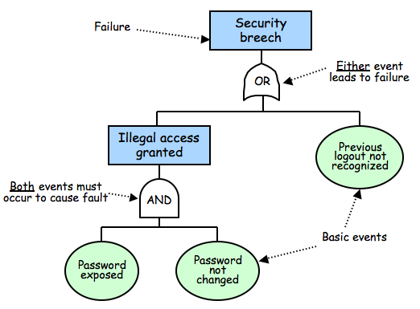
5.7 Architecture Evaluation and Refinement
Safety Analysis (continued)

Slide 53
5.7 Architecture Evaluation and Refinement
Safety Analysis (continued)
Once fault tree is constructed we search for weaknesses
Cut-set tree reveals event combinations can cause failure
  Rules for forming cut-set tree:
    Assign the top node of the cut-set tree to match the logic gate at the top of the fault tree.
    Working from the top down, expand the cut-set tree as follows:
      Expand an or-gate node to have two children, one for each or-gate child
      Expand an and-gate node to have a child composition node listing both of the and-gate children
      Expand a composition node by propagating the node to its children, but expanding one of the gates listed in the node
    Continue until all leaf nodes are basic events or composition nodes of basic events

Slide 54
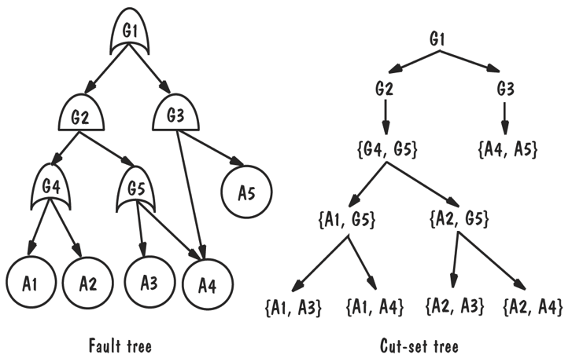
5.7 Architecture Evaluation and Refinement
Safety Analysis (continued)
Once fault is found in design:
  Correct the fault
  Add components or conditions to prevent
  Add components that detect fault and recover from damage

Slide 55
5.7 Architecture Evaluation and Refinement
Security Analysis
Six steps to performing security analysis:
  Software characterization: review documentation for understanding functionality of the system
  Threat analysis: look for threats (e.g., espionage, interception, disruption)
  Vulnerability assessment: includes failure to authenticate user or use of cryptological algorithm that is easy to break
  Risk likelihood determination
  Risk impact determination: business consequences
  Risk mitigation planning: planning to reduce likelihood and consequences of most severe risks

Slide 56
5.7 Architecture Evaluation and Refinement
Trade-off Analysis
Often several alternative designs to consider
  professional duty to explore design alternatives and not simply implement the first design that comes to mind
  different members of design team may promote competing designs
  need a measurement-based method for comparing design alternatives

Slide 57
5.7 Architecture Evaluation and Refinement
One Specification, Many Designs
One specification, many designs: to see how different designs can be used to solve the same problem
Shaw and Garlan present four different architectural designs to implement KWIC (Key Word in Context problem)
    shared data
    abstract data type
    implicit invocation
    pipe and filter

Slide 58
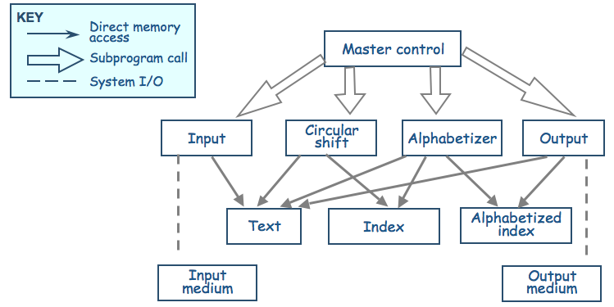
5.7 Architecture Evaluation and Refinement
One Specification, Many Designs (continued)
Shared data solution
Four functional parts: input, circular shift, alphabetize, and output

Slide 59
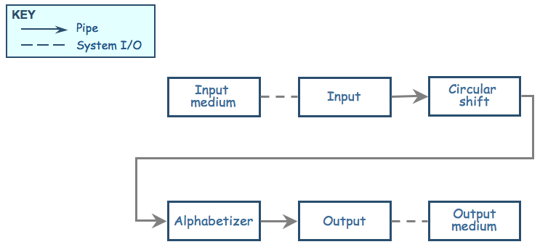
5.7 Architecture Evaluation and Refinement
One Specification, Many Designs (continued)
Pipe-and-filter solution: The sequence of processing is controlled by the sequence of filters

Slide 60
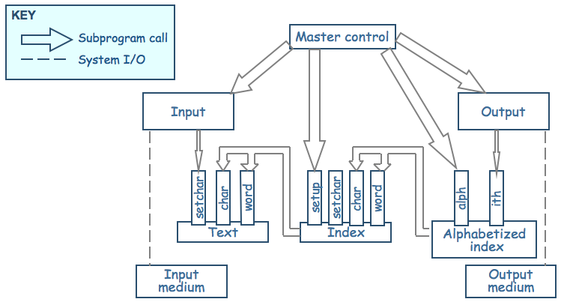
5.7 Architecture Evaluation and Refinement
One Specification, Many Designs (continued)
Data-module solution
Modules form data abstraction (hide data representation)

Slide 61
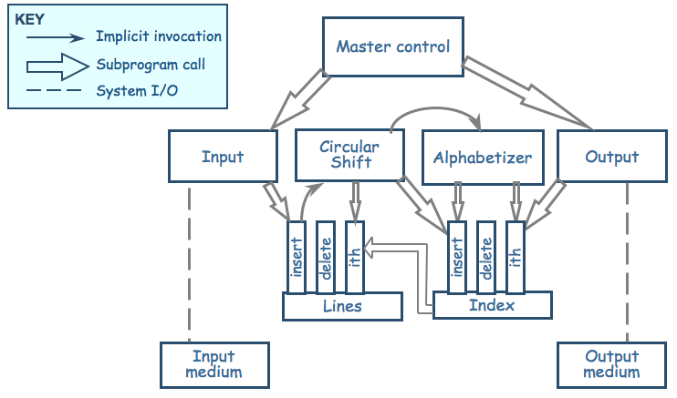
5.7 Architecture Evaluation and Refinement
One Specification, Many Designs (continued)
ADT solution: Data are no longer centralized, stored, and shared, but the decomposition process is similar

Slide 62
5.7 Architecture Evaluation and Refinement
One Specification, Many Designs (continued)
Comparison of KWIC solutions
Attribute | Shared Data | Data Abstraction | Implicit Invocation | Pipe and Filter
Easy to change Algorithm | - | - | + | +
Easy to Change Data | - | + | - | -
Easy to Add Functionality | + | - | + | +
Performance | - | - | + | +
Efficient Data Rep | + | + | + | -
Easy to Reuse | - | + | - | +

Slide 63
5.7 Architecture Evaluation and Refinement
One Specification, Many Designs (continued)
Weighted comparison of KWIC solutions
Attribute | Priority | Shared data | Abstract data type | Implicit invocation | Pipe and filter
Easy to change algorithm | 1 | 1 | 2 | 4 | 5
Easy to change data representation | 4 | 1 | 5 | 2 | 1
Easy to change function | 3 | 4 | 1 | 4 | 5
Good performance | 3 | 5 | 4 | 2 | 2
Easy to reuse | 5 | 1 | 4 | 2 | 5

Slide 64
5.7 Architecture Evaluation and Refinement
Cost-Benefit Analysis
A cost–benefit analysis is a widely used business tool for estimating and comparing the costs and benefits of a proposed change
A cost-benefit analysis contrasts financial benefits with financial costs
  Costs are one time capital expense
  Benefits accrue overtime
Return on Investment (ROI)
  ROI = Benefits/Cost
Payback period
  the length of time before accumulative benefits recover the costs of implementation

Slide 65
5.7 Architecture Evaluation and Refinement
Prototyping
Some design decisions are best answered by prototyping
Prototype: an executable model of the system built to answer specific questions about the system
Throw-away prototype: meant to be discarded
Rapid prototyping: progressively refine the prototype until it becomes the final system

Slide 66
5.8 Documenting Software Architectures
The SAD serves as the repository for design information and includes:
  System overview
  Views
  Software units
  Analysis data and results
  Design rationale
  Definitions, glossary, acronyms

Slide 67
5.8 Documenting Software Architectures
Mappings among Views
Structure of the system and intended measured attributes determine number and type of views to include in SAD
  should at least include decomposition and execution view
Design is collection of views; must show how views relate to one another

Slide 68
5.8 Documenting Software Architectures
Documenting Rationale
Document rationale: outlining critical issues and trade-offs
When to document the rationale behind decision:
  Significant time spent on decision
  Decision is critical
  Decision is counterintuitive
  Costly to change decision

Slide 69
5.9 Architecture Design Review
Design review is an essential part of engineering practice
SAD quality is evaluated in two ways:
  Validation: making sure the design satisfies all of the customer’s requirements (i.e., is this the right system?)
  Verification: ensuring the design adheres to good design principles (i.e., are we building the system right?)

Slide 70
5.9 Architecture Design Review
Validation
Several key people included in review:
  The analyst(s) who helped define the system requirements
  The system architect(s)
  The program designer(s) for this project
  A system tester
  A system maintainer
  A moderator
  A recorder
  Other interested developers not otherwise involved in this project

Slide 71
5.9 Architecture Design Review
Verification
Judge whether it adheres to good design principles:
  Is the architecture modular, well structured, and easy to understand?
  Can we improve the structure and understandability of the architecture?
  Is the architecture portable to other platforms?
  Are aspects of the architecture reusable?
  Does the architecture support ease of testing?
  Does the architecture maximize performance, where appropriate?
  Does the architecture incorporate appropriate techniques for handling faults and preventing failures?
  Can the architecture accommodate all of the expected design changes and extensions that have been documented?

Slide 72
5.9 Architecture Design Review
Verification (continued)
Active design review: exercise the design document by using it in ways the developers will use the final document in practice
Passive review process: reading the documentation and looking for problems

Slide 73
Summary
Architectural Design Process
  Modeling: architectural styles
  Analysis: achieving quality attributes, evalutaion methods
  Documentation: software architecture document
  Review: validation and verifiation
The goal is not to design the ideal software architecture for a system, because such an architecture might not even exist. Rather, the goal is to design an architecture that meets all of the customer’s requirements while staying within the cost and schedule constraints

